Slide 1
Checkout Experiment & Growth Analytics System
A/B Test Analysis & Business Impact Assessment
Name: Nunna Ramacharan
Course / Capstone Project
Date: 01-3-2026
Student id : bitsom_ba_2507521

Slide 2
Business Goal & Success Metrics
Business Goal:
Improve checkout conversion while maintaining revenue per session.
Primary KPI:
Revenue per Session (RPS)
Supporting KPIs:
• Conversion Rate
• Checkout ? Purchase %
• Average Order Value
• Time to Purchase

Slide 3
Executive Summary — Checkout Experiment Decision
Objective: Improve checkout conversion while
protecting revenue per session.
  Conversion: A = 8.40% | B = 9.97% (+18.7% lift, statistically significant).
  Revenue per Session: A = ₹416.51 | B = ₹453.87 (+9.0%).
  Projected 30-day incremental orders: +43.
  Projected 30-day incremental revenue (Base Case): ₹2.88 Lakhs.

Slide 4
Data & Methodology
Data Sources:
• Sessions dataset
• Orders dataset
• User attributes dataset
Processing Steps:
• Data cleaning
• Funnel event mapping
• Session aggregation
• Revenue attribution
• Feature engineering
Metrics Engineered:
• has_product_view
• has_add_to_cart
• has_begin_checkout
• has_payment_attempt
• has_purchase

Slide 5
Root Cause Analysis
Key Insights:
• Product ? Cart biggest leakage
• Landing ? Product secondary friction
• Checkout stage performs well
• Time-to-step analysis shows delays before purchase
Interpretation:
Problem occurs before checkout rather than payment stage.

Slide 6
Funnel Diagnosis & Root Cause
Product → Cart drop-off: 69.4% (largest leakage).
  Cart → Checkout drop-off: 32.2%.
  Checkout → Purchase conversion: 71.1%.
  Median drop before cart: 15 seconds.
  Mobile & paid social segments show weaker progression.

Slide 7
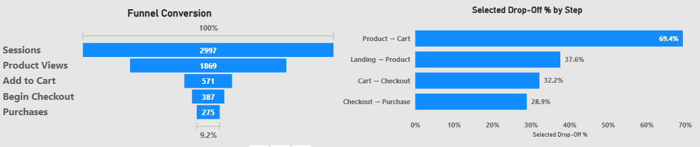
User Funnel Diagnosis
Key Insight:
Largest drop-off occurs at Product ? Cart (69.4%).
Many users view products but do not add items to cart.

Slide 8
Segment Performance Analysis
Key Findings:
• Premium segment shows highest conversion uplift
• Web users outperform mobile traffic
• Email & referral channels generate highest revenue/session

Slide 9
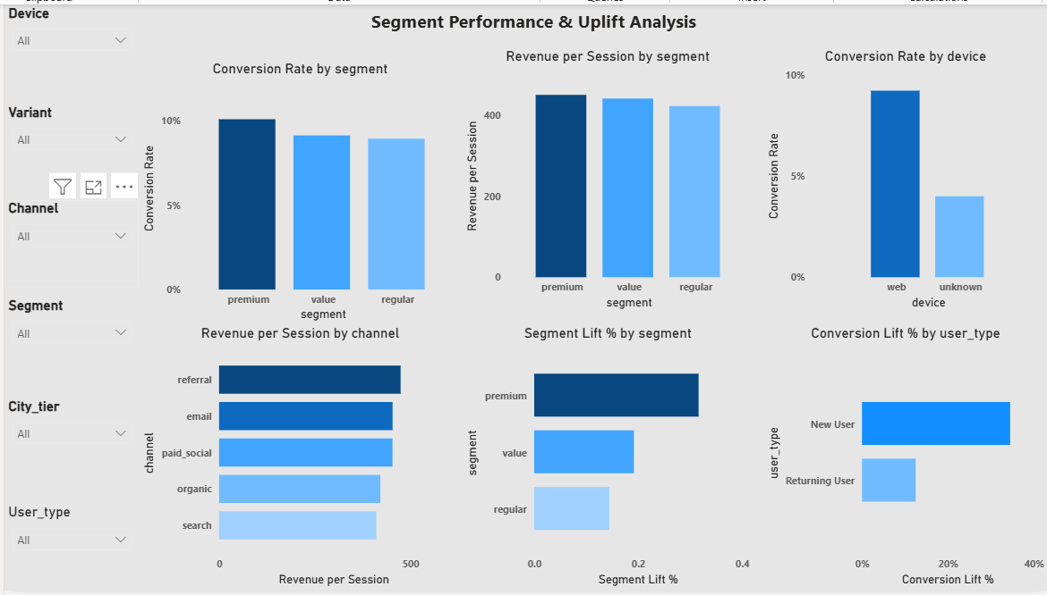

Slide 10
A/B Experiment Outcome
Variant A Conversion: 8.40%
Variant B Conversion: 9.97%
Conversion Lift: +18.7%(p < 0.05).
Revenue per Session Lift: +9.0%
Decision:
Variant B improves checkout efficiency and overall revenue.

Slide 11
Heterogeneous Treatment Effects (HTE-lite)
Segments benefiting most:
• Premium users
• Web traffic
• New users
Segments with lower uplift:
• Mobile traffic
• Paid social channels

Slide 12
Projected 30-Day Business Impact
Projected Incremental Orders: +43
Projected Incremental Revenue: 2.88Lakhs
Sensitivity Range (±25%):
Best Case: 3.26 Lakhs
Worst Case: 2.16 Lakhs
Assumptions:
• Traffic remains stable
• Conversion lift sustained

Slide 13
Strategic Recommendations (MoSCoW)
Must:
• Rollout Variant B for web traffic
• Monitor revenue per session weekly
Should:
• Improve Product ? Cart UX
• Optimize mobile paid social traffic
Could:
• Run AOV optimization experiment

Slide 14
Risks & Follow-Up Experiments
Risks:
• Revenue sensitive to AOV changes
• Segment imbalance during rollout
• Short experiment duration
Next Experiments:
• Mobile checkout UX experiment
• Product page optimization test
• Upsell experiment to improve AOV

